Slide 1
Session 4
Program Control
Statements - 1

Slide 2
Session Objectives
Explain the selection constructs
The if statement
The if….else statement
The if..else…if…else statement
Nested ifs
The switch statement
Nested switch

Slide 3
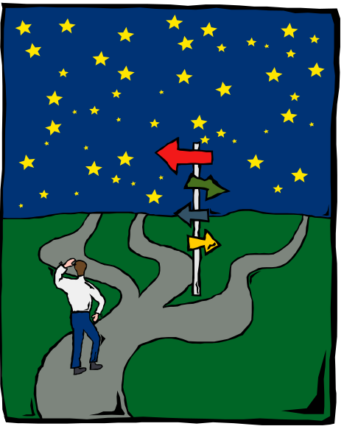
Introduction (1)
Control flow statements are used to
change the flow of programs after a
test or decision is taken

Slide 4
Introduction (2)
Program control statements
Decision constructs
OR
Branching statements
Iteration constructs

Slide 5

Decision Constructs
Fundamentally 3 constructs
if
if - else
switch

Slide 6
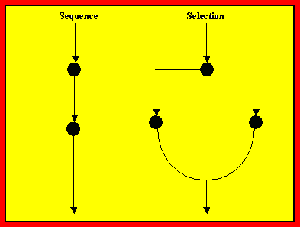
Flow of Control

Slide 7
Simple Selection ( if ) (1)
if (expression)
Processing statement_1 ;
Executes when if(expression)= TRUE
Processing statement_2 ;
Executes when if(expression) = False
or
after completion of processing statement following if(expression)

Slide 8
Simple Selection ( if ) (2)
The ‘if’ construct can have more than
one processing statements enclosed
in curly braces
if (expression)
{
Processing statement 1 ;
Processing statement 2 ;
}

Slide 9
Simple ‘ if ’ Example
#include <iostream.h>
#include <conio.h>
void main(void)
{
char grade ;
int score ;
cout << "Enter the score: " ;
cin >> score ;
cout << endl ;
if(score >= 70)
{
grade = 'A' ;
cout << "Excellent. Grade: " << grade ;
}
}
Enter the score: 70
Excellent. Grade: A

Slide 10
Two way selection (1)
if (expression)
Processing statement 1
else
Processing statement 2
if (expression)
Processing statement 1
else if(expression)
Processing statement 2
else
Processing statement 3

Slide 11
Two way selection (2)
Enter the score: 75
Excellent. Grade: A
Enter the score: 56
Average. Grade: B
if(score >= 70)
{
grade = 'A' ;
cout << "Excellent. Grade: " << grade ;
}
else
{
grade = 'B' ;
cout << "Average. Grade: " << grade ;
}

Slide 12
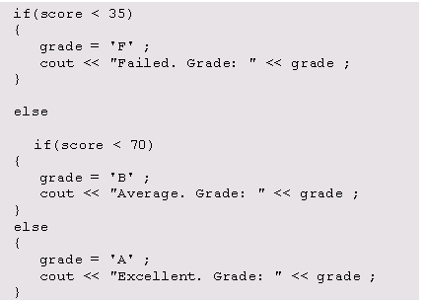
Two way selection (3)
Enter the score: 34
Failed. Grade: F
Enter the score: 56
Average. Grade: B
Enter the score: 75
Excellent. Grade: A

Slide 13
Nested ‘ if ‘ statement
if (expression 1)
{
if (expression 2)
{
Processing statement 1;
Processing statement 2;
}
}
An if
Within
an if

Slide 14
Switch statement (1)
Multi-way
decision-making
construct

Slide 15
Switch statement (2)
Test whether an
expression matches a
number of
constant values
and branches
accordingly

Slide 16
Switch statement (3)
switch (expression)
{
case value 1 : Processing statements
break ;
case value 2 : Processing statements
break ;
default : Processing statements
}
Neater alternative to if else

Slide 17
Switch statement (4)
The body of the switch statement should
be enclosed in braces
The values with case should be constants
In switch
If any of the values match, the statements
following that case till break are executed
The keyword ‘break’ is used to indicate the
end of processing statements under a case

Slide 18
Keyword Default
If none of the case values match the result of the expression, then the statements following default , which is optional, are executed

Slide 19
Menu structure programs (1)
switch(dest_choice)
{
case 1 : cout << "Delhi" ;
break ;
case 2 : cout << "Mumbai" ;
break ;
case 3 : cout << "Chennai" ;
break ;
case 4 : cout << "Calcutta" ;
break ;
case 5 : cout << "Bangalore" ;
break ;
case 6 : clrscr() ;
break ;
default : clrscr() ;
cout << "Invalid entry. Valid (1-6)" ;
break ;
}

Slide 20
Menu structure programs (2)
1. Delhi
2. Mumbai
3. Chennai
4. Calcutta
5. Bangalore
6. Exit
Choose your destination (1-5) or enter 6 to exit: 3
Destination chosen: Chennai

Slide 21
Omission of ‘break’(1)
The break statement can be omitted when the same operation is to be performed for a number of cases

Slide 22
Omission of ‘break’(2)
char ch ;
cout << "Enter a vowel / consonant / space: " ;
ch = getche() ;
cout << endl ;
switch (ch)
case ‘a’ :
case ‘e’ :
case ‘i’ :
case ‘o’ :
case ‘u’ :cout << "You entered a vowel" << endl;
break ;
case ‘ ‘ :cout << "You entered a space" << endl ;
break ;
default : cout << "You entered a consonant"<< endl ;
break ;
}
getche() is used to accept one
character as input
including space

Slide 23
Omission of ‘break’(3)
Output 1
Enter a vowel / consonant / space:
You entered a space
Output 2
Enter a vowel / consonant / space: a
You entered a vowel

